Slide 1

Usage of ClusterR Package
Alessio Corrado Francesco Zuccato
2022/2023
Applied Statistics & Data Analysis
Department of Mathematics, Computer Science and Physics
University of Udine

Slide 2

Contents
Introduction
Unsupervised learning
Cluster analysis
Data generation
ClusterR Package
Provided models for clustering
Execution times
Centroid vs medoids
Provided datasets

Slide 3
Unsupervised Learning
Cluster Analysis methods
Connectivity based
Agglomerative (Divisive) Hierarchical Clustering
Centroid based
K-Means, K-Medoids
Distribution based
Gaussian Mixture Models
Density based
DBSCAN

Slide 4
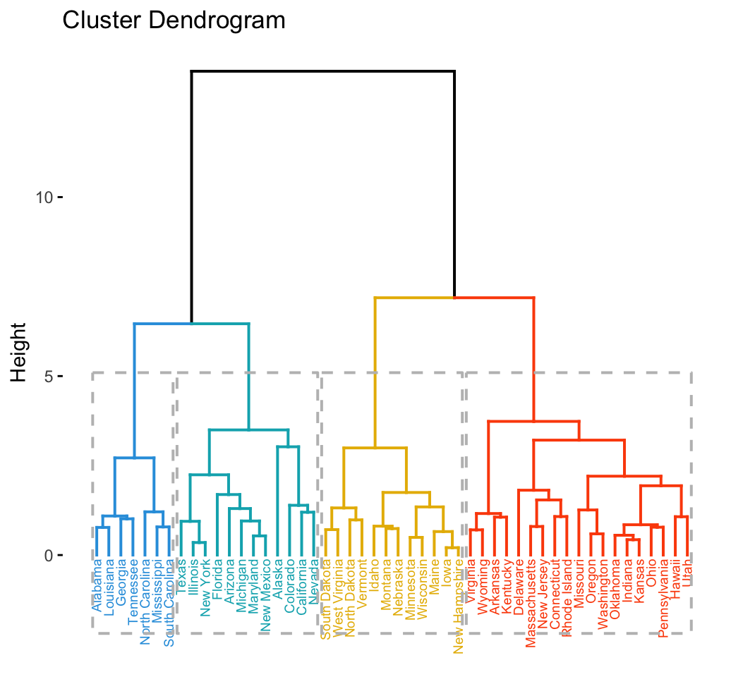
1. Connectivity based
Create connections between clusters
Tree vs forest
Agglomerative (Divisive) Hierarchical Clustering

Slide 5

2. Centroid based
Centroid (K-means)
Medoid (K-medoid)

Slide 6
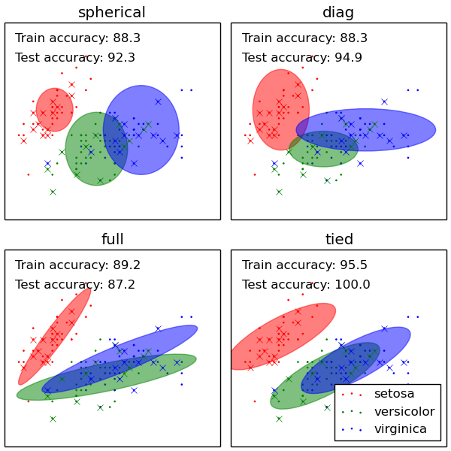
3. Distribution based
Data explained by a probabilistic model
each observation belongs to the cluster that maximizes the generating probability
Generalizes centroid-based
all centroids has the same gaussian distribution
Gaussian Mixture Models

Slide 7
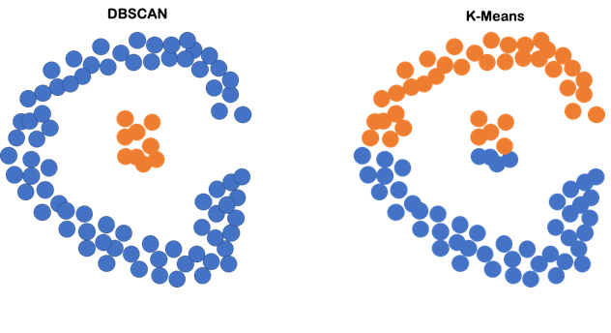
4. Density based
Distance between points
Dense connected regions
No prior number of clusters
DBSCAN, OPTICS

Slide 8
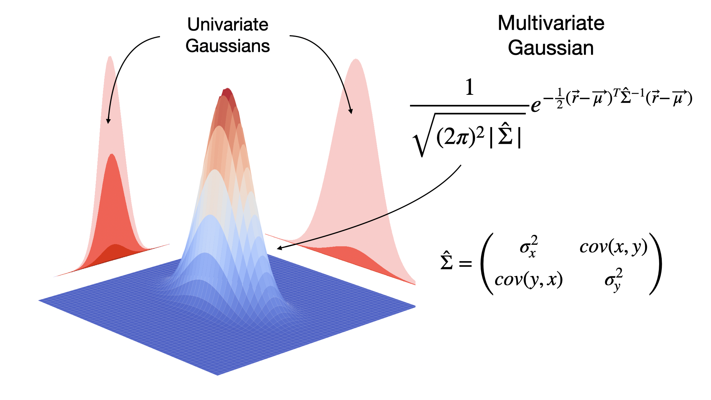
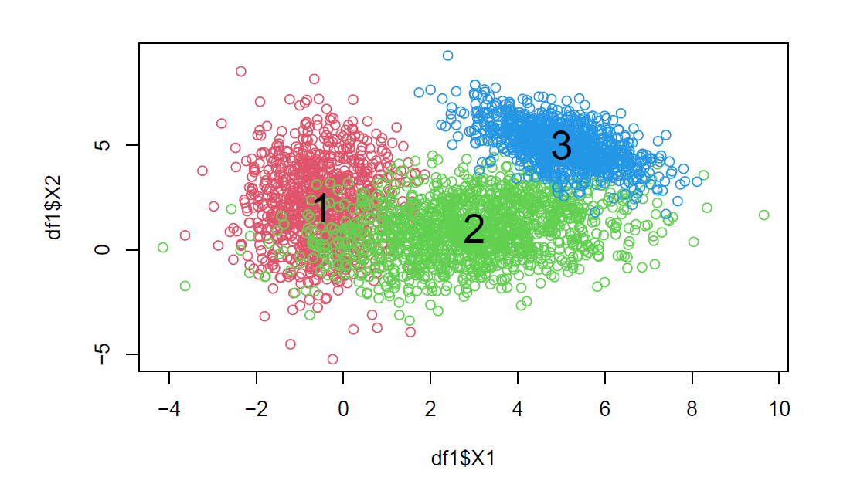
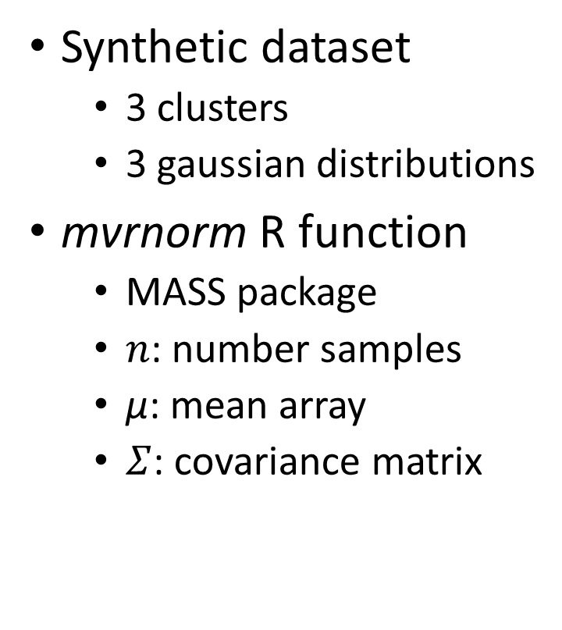
Data Generation
Synthetic dataset
3 clusters
3 gaussian distributions
mvrnorm R function
MASS package
$n$: number samples
$\text{μ}$: mean array
$Σ$: covariance matrix

Slide 9
ClusterR Package
Clustering Methods
Gaussian Mixture Models: GMM
K-Means: Kmeans_arma vs Kmeans_rcpp
K-Medoids: Cluster_Medoids vs Clara_Medoids
Automated choice of K
Other Methods
Plot 2D
Plot Silhouette Dissimilarity
External Validation

Slide 10
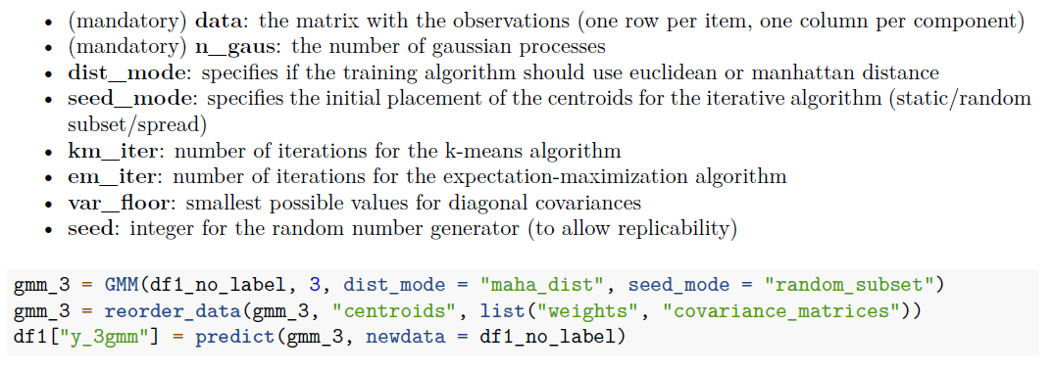
1. Gaussian Mixture Models
Input

Slide 11
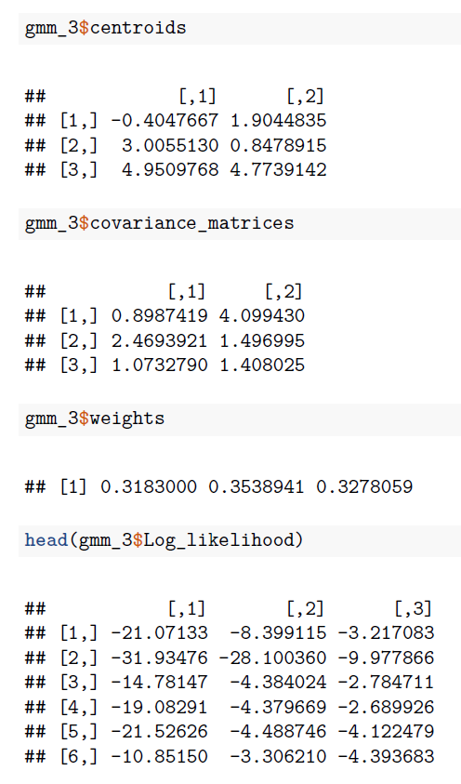
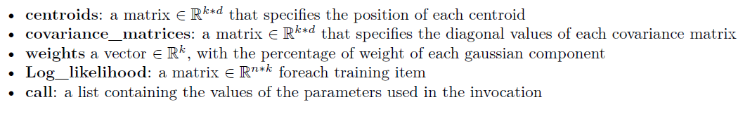
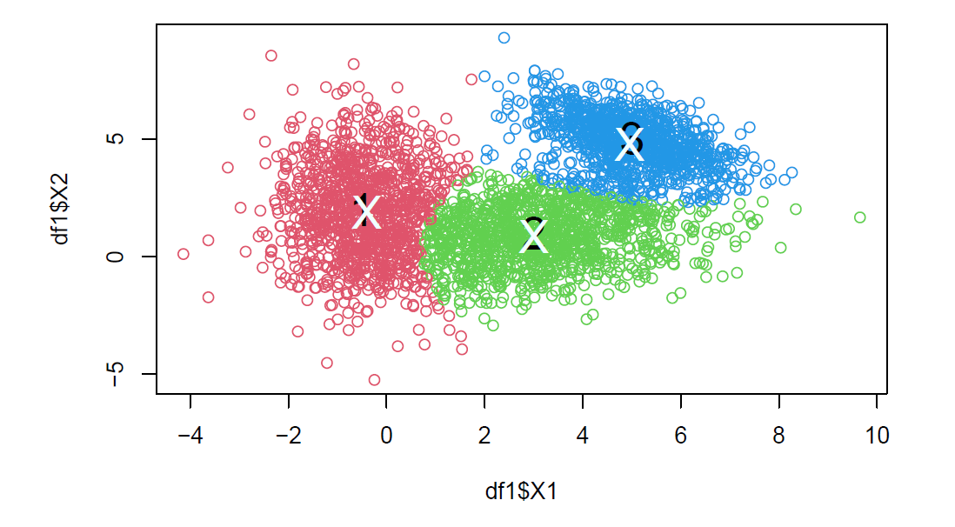
1. Gaussian Mixture Models
Output

Slide 12
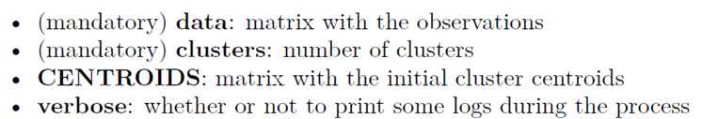
2. K-means
Arma vs Rcpp
Shared parameters:
KMeans_arma pros:
ready-to-go approach
faster than KMeans_rcpp:
returns only the matrix of the centroids
can work in parallel with OpenMP
KMeans_rcpp pros:
Many more initialization and running settings

Slide 13
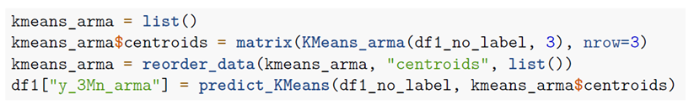
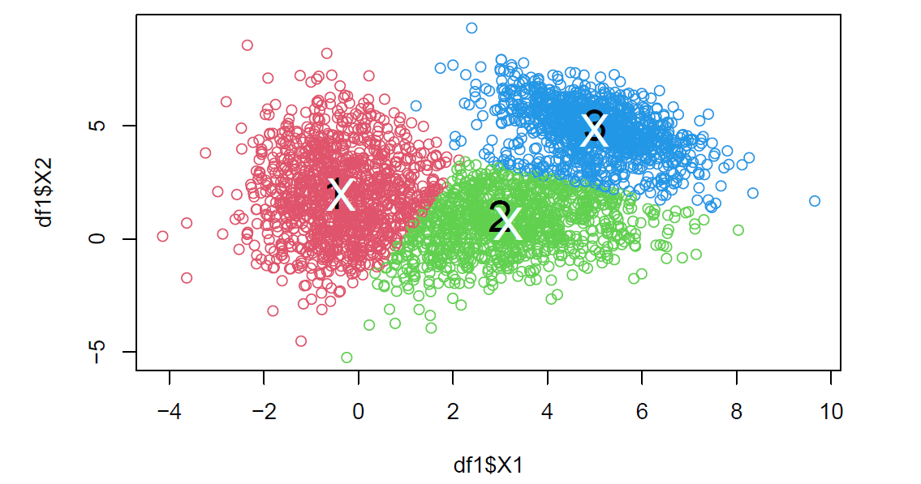
2. K-means
Arma: Armadillo Implementation

Slide 14
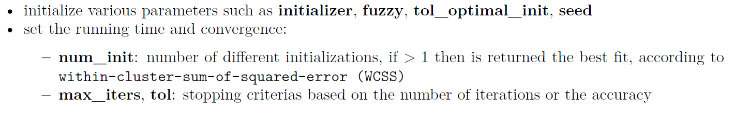
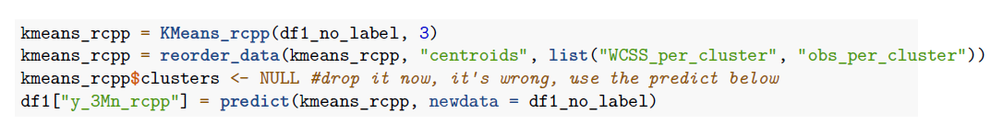
2. K-means
Rcpp: RcppArmadillo Implementation
Additional input parameters:

Slide 15
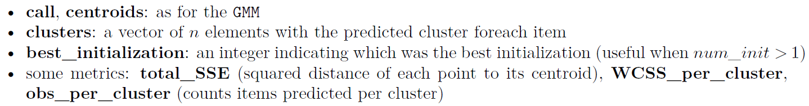
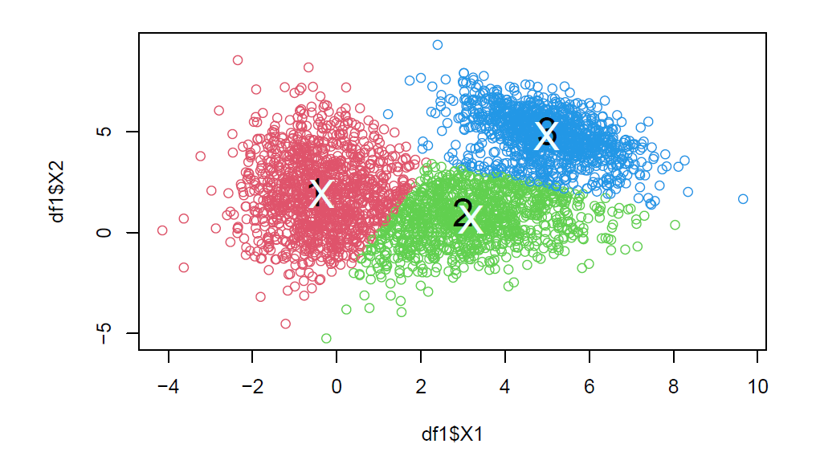
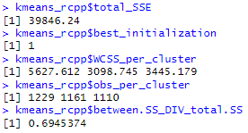
2. K-means
Rcpp: RcppArmadillo Implementation
Output:

Slide 16
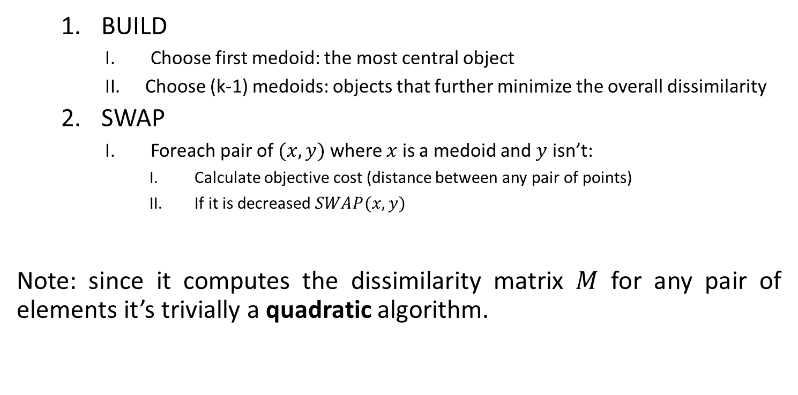
3. K-medoids
Partitioning Around Medoids (PAM)
BUILD
Choose first medoid: the most central object
Choose (k-1) medoids: objects that further minimize the overall dissimilarity
SWAP
Foreach pair of $(x,y)$ where $x$ is a medoid and $y$ isn’t:
Calculate objective cost (distance between any pair of points)
If it is decreased $SWAP(x,y)$
Note: since it computes the dissimilarity matrix $M$ for any pair of elements it’s trivially a quadratic algorithm.

Slide 17
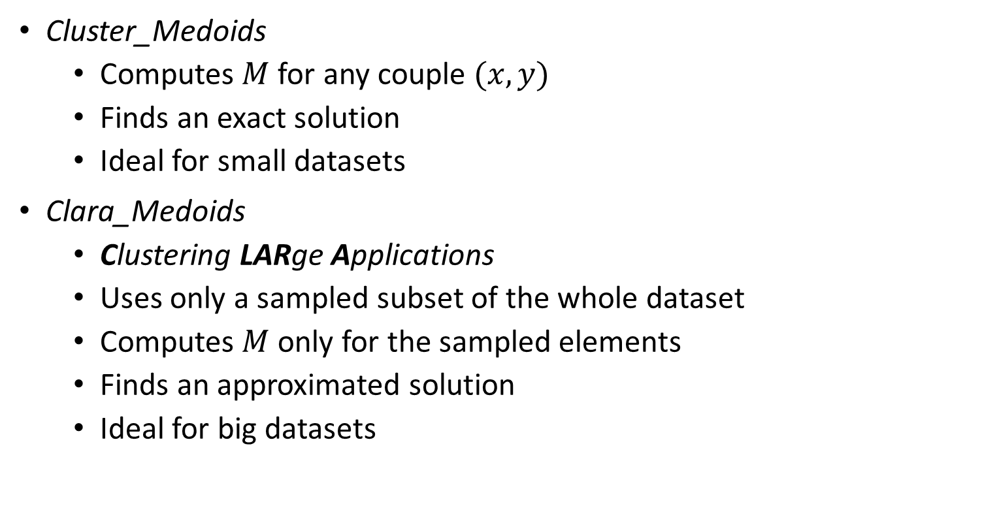
3. K-medoids
Cluster vs Clara
Cluster_Medoids
Computes $M$ for any couple $(x,y)$
Finds an exact solution
Ideal for small datasets
Clara_Medoids
Clustering LARge Applications
Uses only a sampled subset of the whole dataset
Computes $M$ only for the sampled elements
Finds an approximated solution
Ideal for big datasets

Slide 18
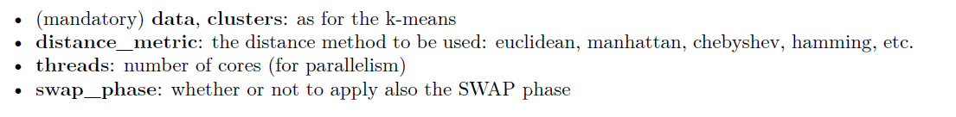
3. K-medoids
Cluster vs Clara
Shared parameters:
Additional Clara parameters:

Slide 19
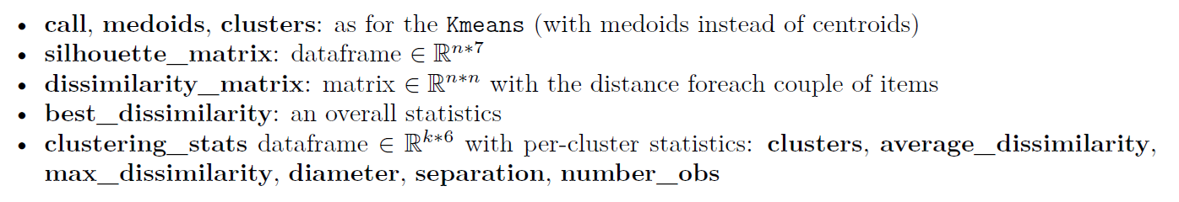
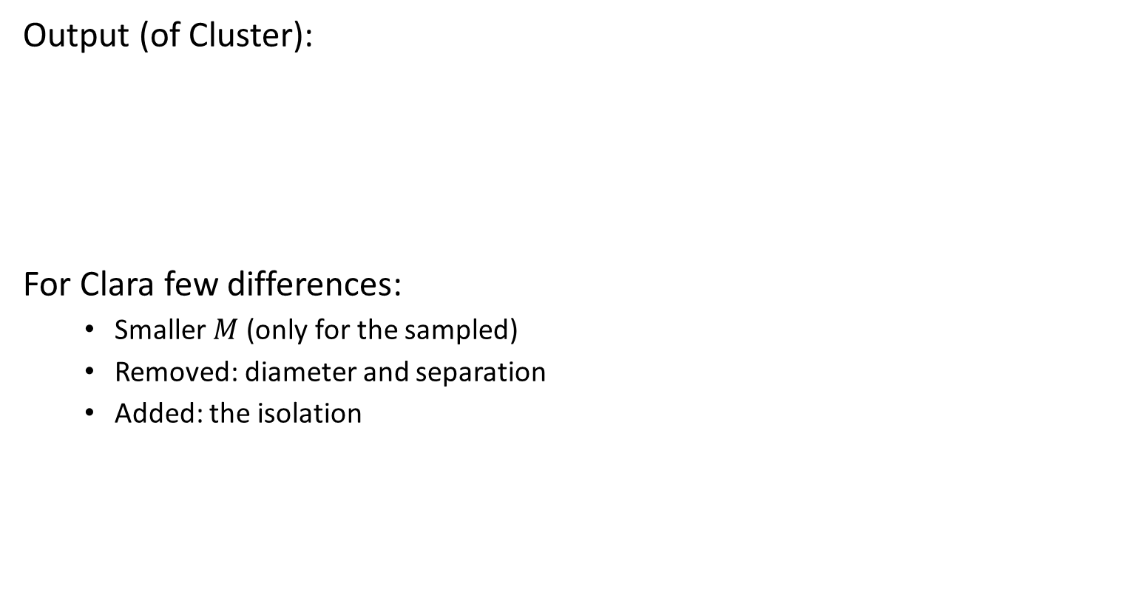
3. K-medoids
Cluster vs Clara
Output (of Cluster):
For Clara few differences:
Smaller $M$ (only for the sampled)
Removed: diameter and separation
Added: the isolation

Slide 20
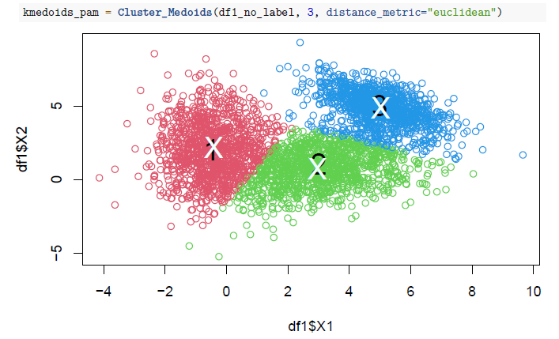
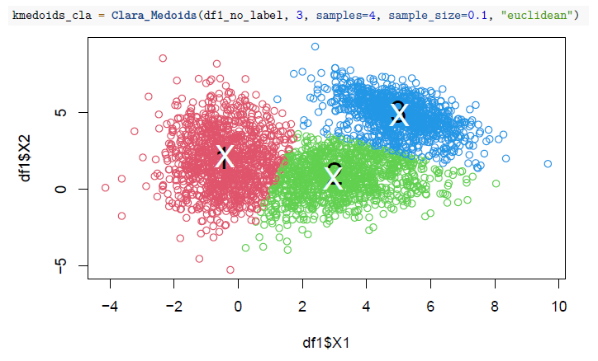
3. K-medoids
Cluster vs Clara
Cluster Medoids Clara Medoids

Slide 21
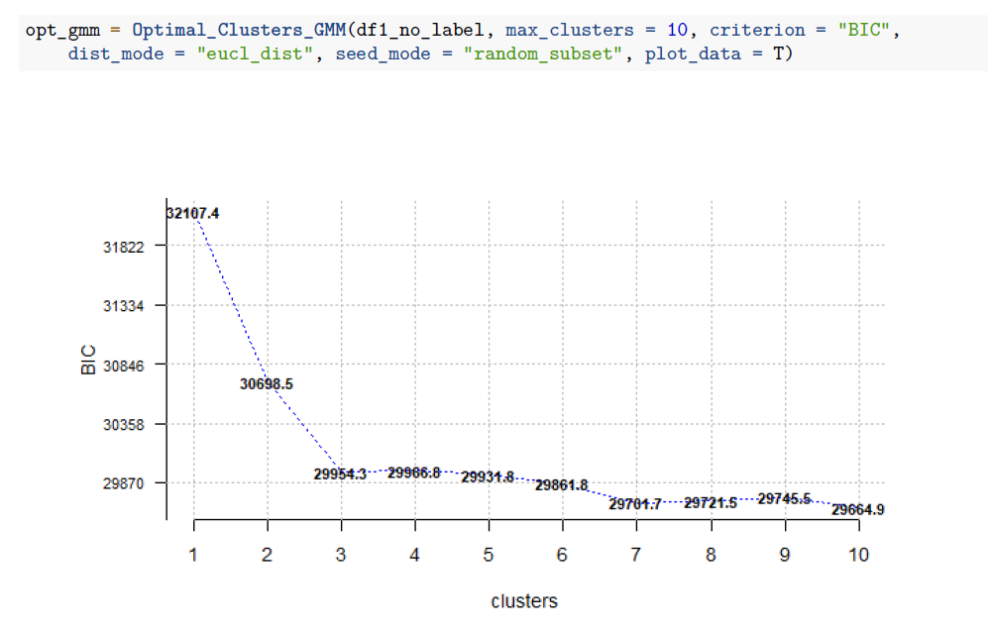
Finding optimal number of clusters
Optimal_Clusters_[method]
[Method]: GMM, KMeans, KMedoids
Additional parameters:
max_clusters, criterion
For the choice (simplest way):
Choose a criterion
Plot: k vs criterion
Choose k: Elbow method

Slide 22
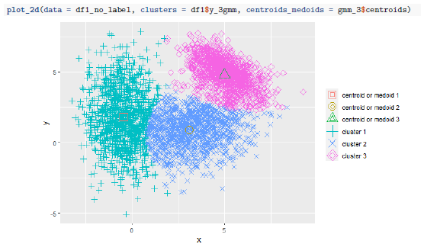
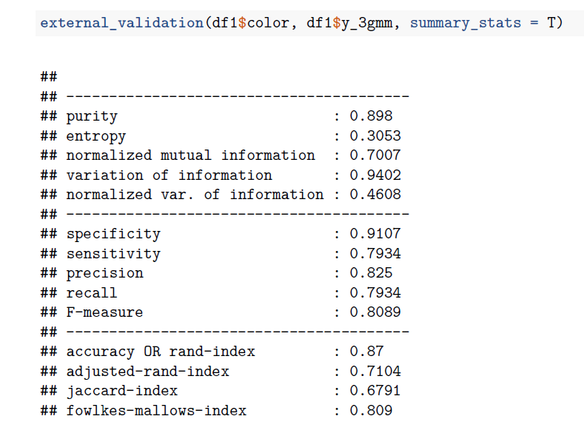
Plot_2d, External_validation
Plot_2d: generates a scatter plot which colors the clusters, adds the centroids and the legend. Params:
Clusters: predictions
Centroids_medoids
External_validation: given the real clusters and the predicted, prints some metrics. Params:
real, predicted clusters
method: to return, default adj R^2

Slide 23
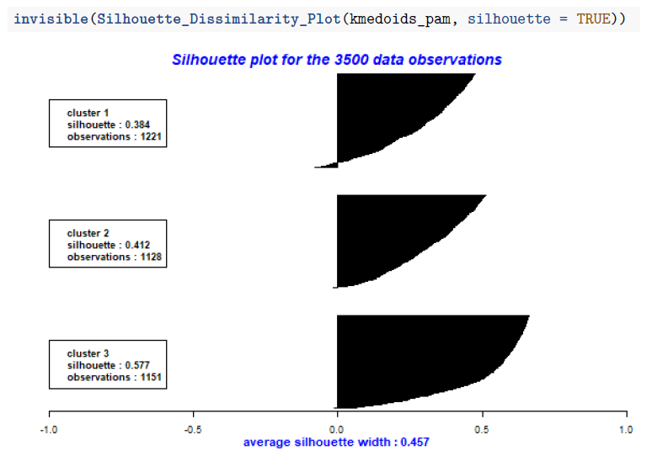
Silhouette Dissimilarity Plot
Average Silhouette Width
Visual way to evaluate the clusters built with the medoids algorithm
Cohesion: object should be similar to others in its own cluster
Separation: object should be dissimilar to others in other clusters
Range: [−1, +1]
Goal: to maximize it

Slide 24
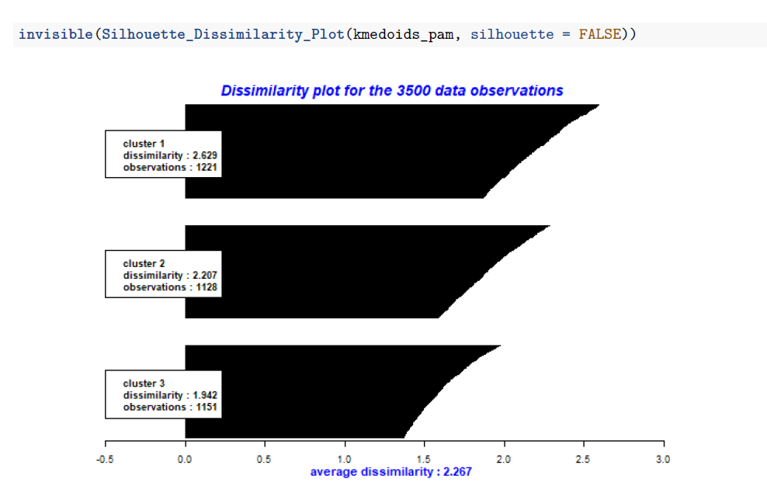
Silhouette Dissimilarity Plot
Average Dissimilarity
Visual way to evaluate the clusters built with the medoids algorithm
Dissimilarity: calculated per cluster

Slide 25
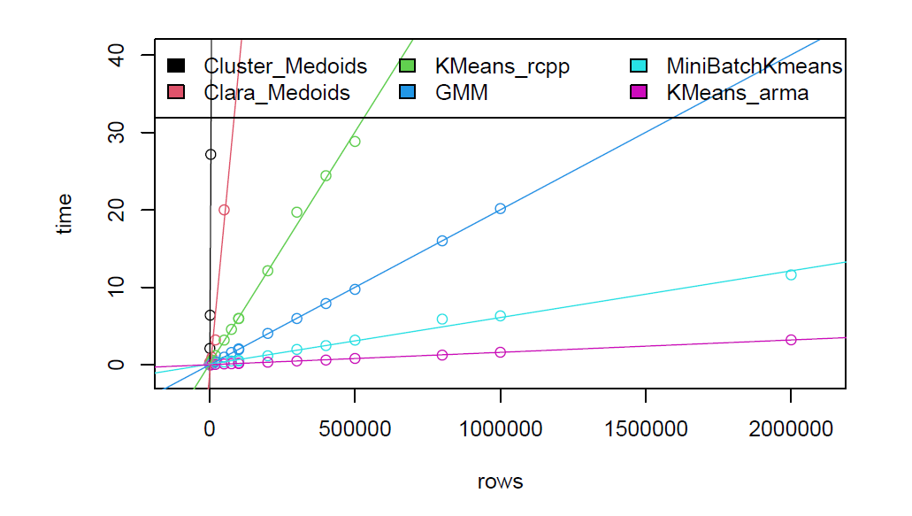
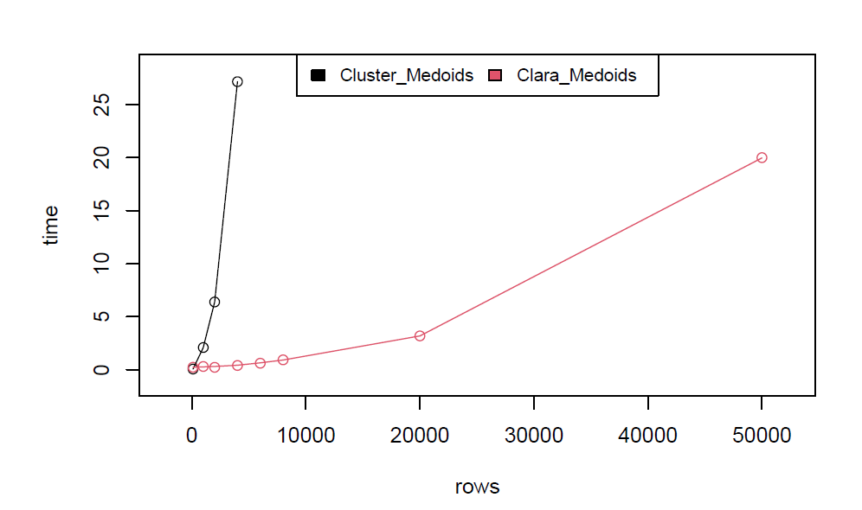
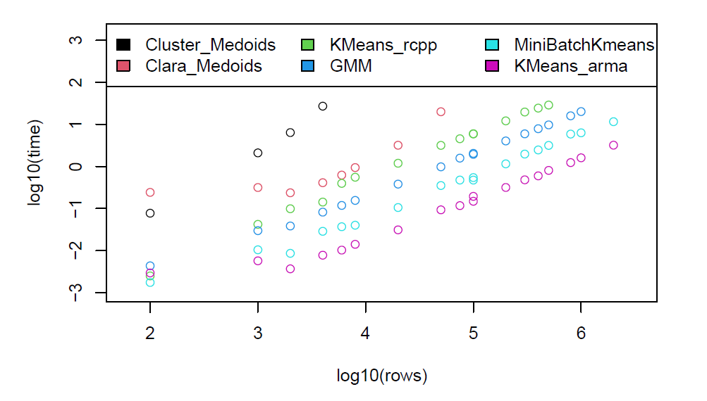
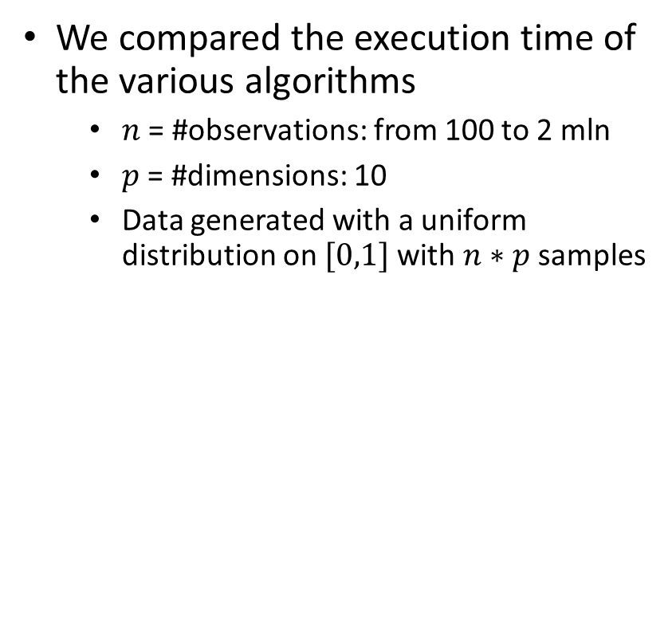
Execution times
We compared the execution time of the various algorithms
$n$ = #observations: from 100 to 2 mln
$p$ = #dimensions: 10
Data generated with a uniform distribution on $[0,1]$ with $n∗p$ samples

Slide 26
Execution times
Considerations
For each algorithm with drop1 we compared three different linear models:
L: Linear
Q: Quadratic
LQ: Linear + Quadratic
Results
K-Means and GMM fit the L model
K-Medoids are quadratic fit the Q model

Slide 27
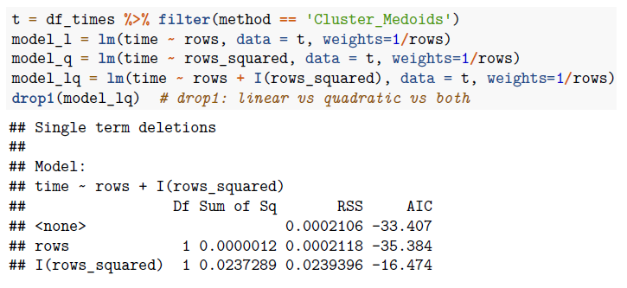
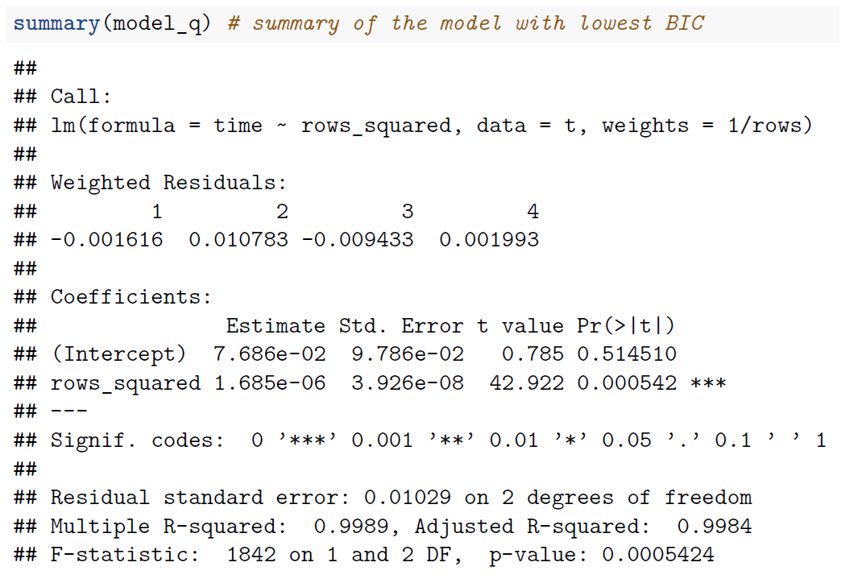
Cluster Medoids
Execution Times
The AIC slightly suggests Q vs LQ model
The Q model seems fair
The quadratic effect is confirmed by p-value

Slide 28
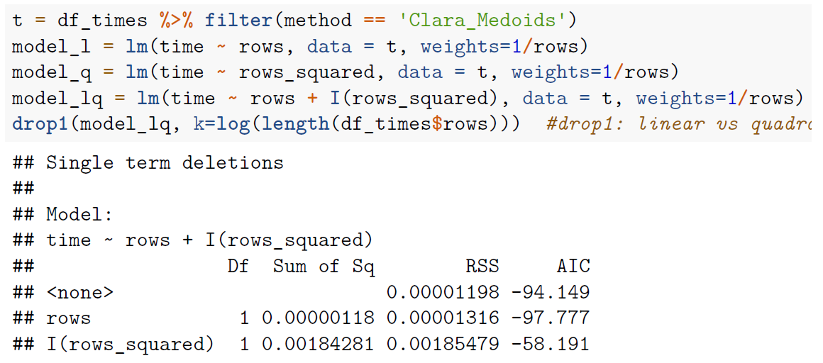
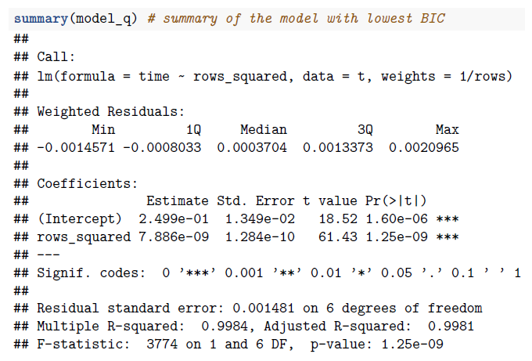
Clara Medoids
Execution Times
Same considerations apply for Clara, of course the quadratic effect depends only the number of sampled elements
The BIC slightly suggests Q vs LQ model
The Q model seems fair
The quadratic effect is confirmed by p-value

Slide 29
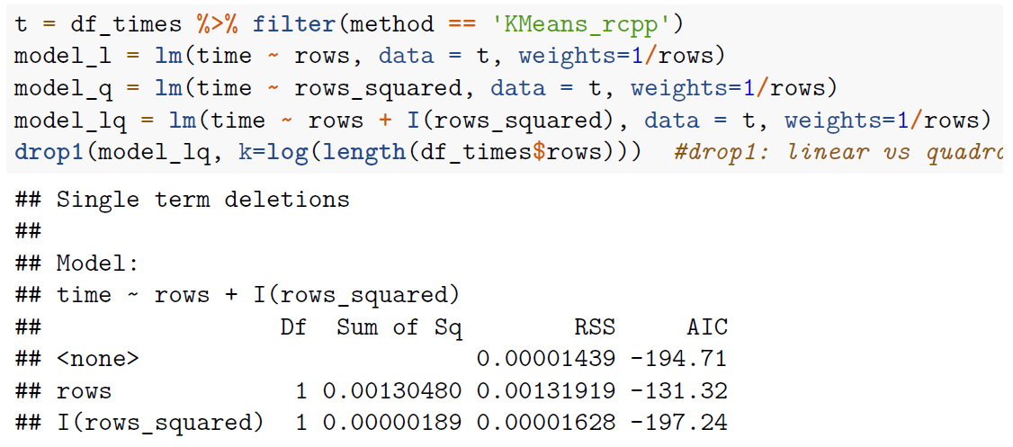
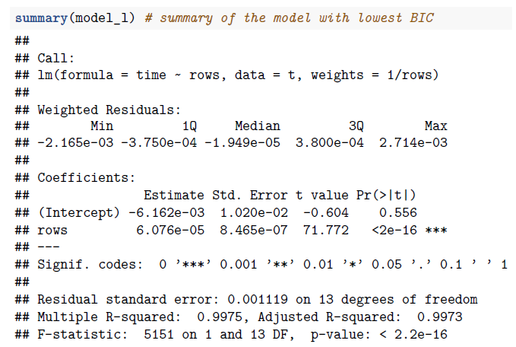
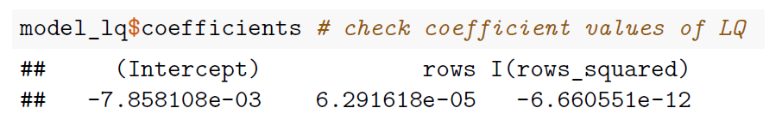
K-Means Rcpp
Execution Times
The BIC slightly suggests L vs LQ model
The L model seems fair
The linear effect is confirmed by p-value
In any case, the quadratic coefficient in the LQ model is insignificant (and negative!)
For Arma and MiniBatch hold same considerations

Slide 30
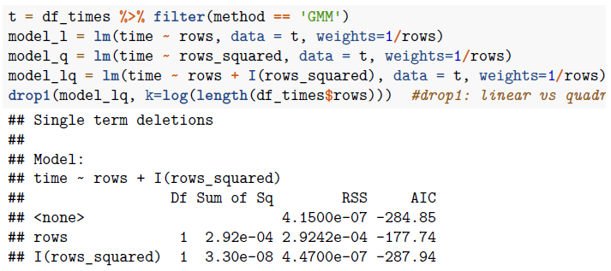
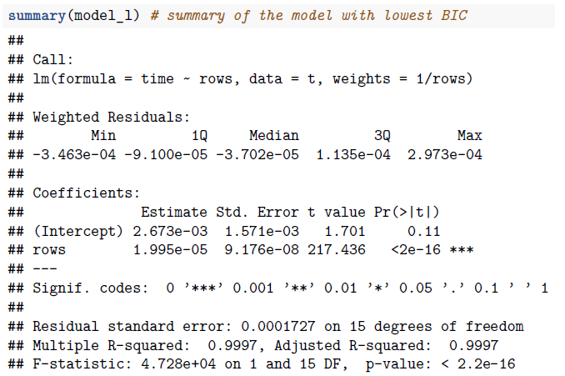
GMM
Execution Times
The BIC slightly suggests L vs LQ model
The L model seems fair
The linear effect is confirmed by p-value
In any case, the quadratic coefficient in the LQ model is insignificant and has a very high p-value

Slide 31
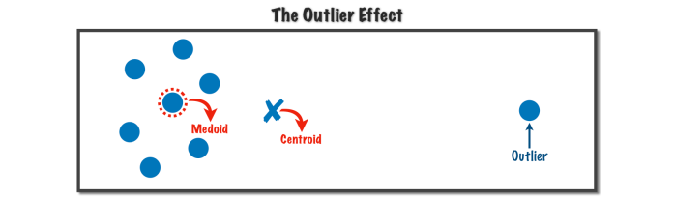
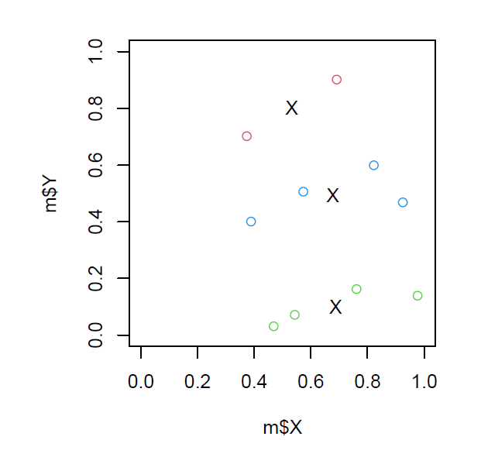
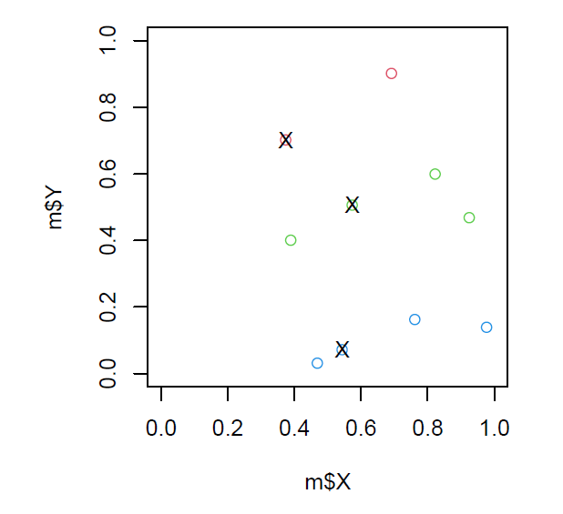
Centroids vs Medoids
K-Medoids pros: robustness to noise and outliers
K-Means pros: fast (linear)
We gave an example of the two algorithms with 10 representations
K-Means
K-Medoids

Slide 32
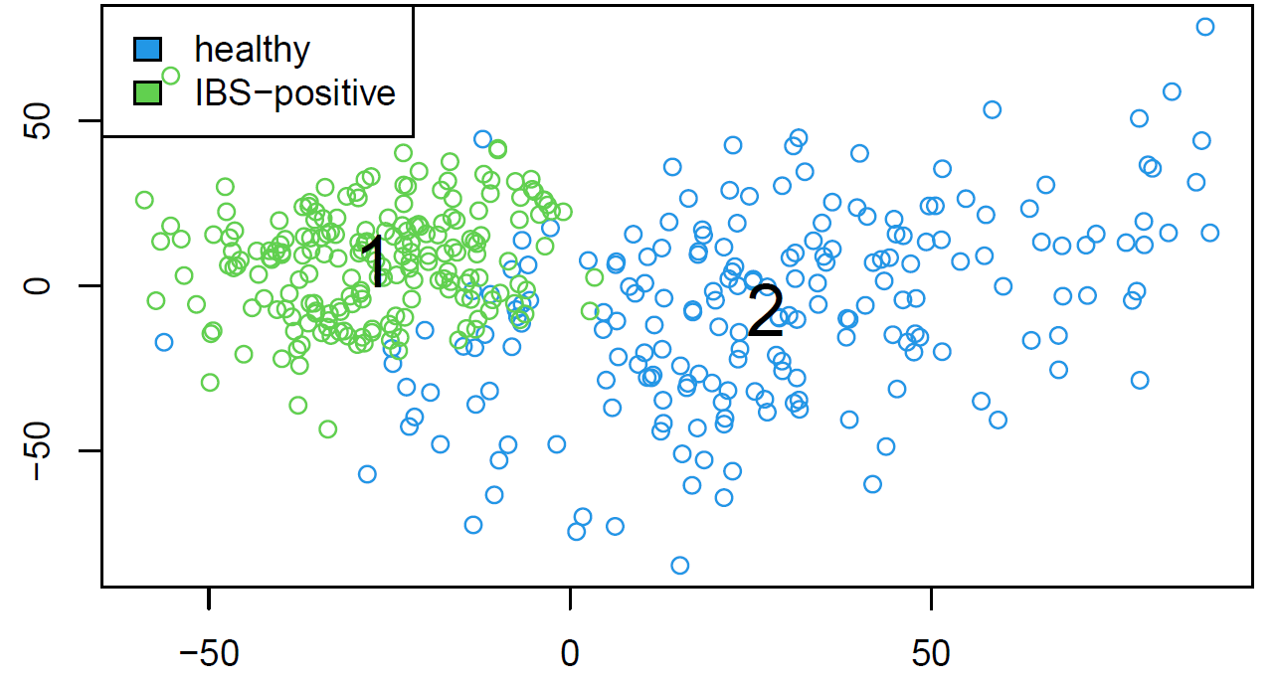
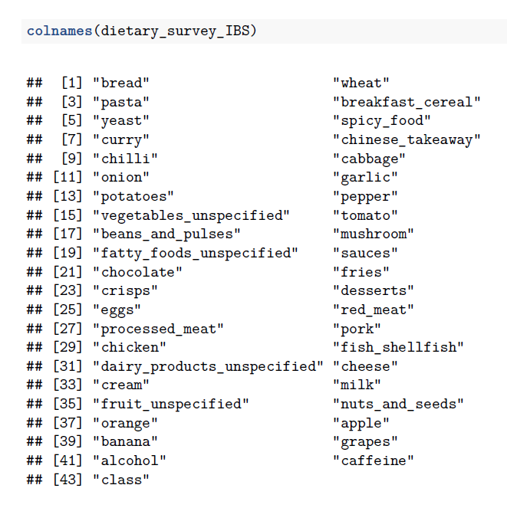
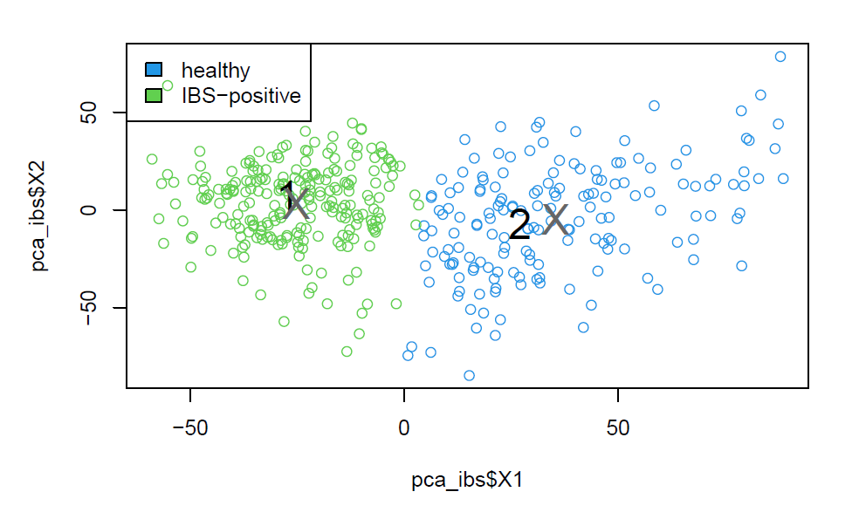
Dataset 1: Dietary Survey IBS
Synthetic data
400 rows, 42 explanatory variables
1 binary response variable class:
healthy or IBS-positive (50% each)
Performed PCA and run KMeans_rcpp
First two PCA scores, real classes
First two PCA scores, predicted classes

Slide 33
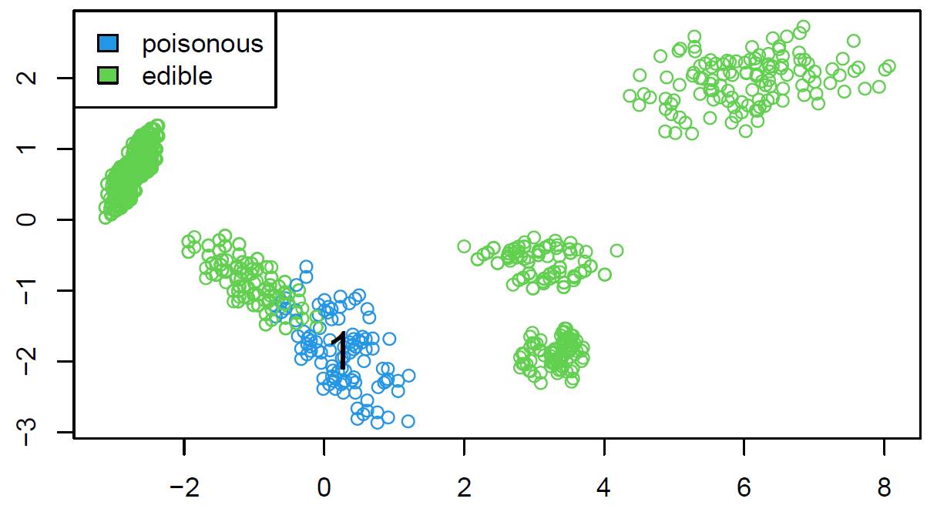


Dataset 2: Mushrooms
Hypothetical samples of 23 species of gilled mushrooms
8124 rows, 22 explanatory variables
1 binary response variable class:
edible (48%) or poisonous (52%)
Performed PCA and run KMeans_rcpp
First two PCA scores, real classes
First two PCA scores, predicted classes

Slide 34


Dataset 3: Soybean
Soybeans characteristics from the UCI machine learning repository
307 rows, 35 explanatory variables
1 categorical response variable class:
19 different classes
Performed PCA and …
not separable in 2D
First two PCA scores, real classes

